Slide 1
Frostwing Preliminary CFD Results
SAE G-12 AWG
Montreal 2017
Pekka Koivisto
Aalto University
Arteform Ltd

Slide 2
CFD Studies
Objective: study the possibility to estimate the fluid loss in time computationally without experiments
Initially a flat plate with a fluid layer in an accelerating airstream
If the preliminary studies were successful there will be a theoretical method available to study the effects of fluid properties (density, viscosity and surface tension) on the fluid loss rate and FPET B-L displacement thickness

Slide 3
CFD Studies
Due to limited time/resources a 2D flat plate model was chosen
Code applied: OpenFoam
2 solvers available for 2-phase flow in OpenFoam code:
  multiphaseEulerFoam
  multiphaseInterFoam supports Non-Newtonian viscosity models, better stability, allows either LES or RANS turbulence models → this solver was selected
2D grid for 0.6m long flat plate: 165 000 cells - recent trials with 1.8m flat plate with 480 000 cells
Initial time step for 2D simulations 5*10⁻⁶ s → 5 second simulation for a 0.6m flat plate takes 2 weeks with 2 CPUs.

Slide 4
CFD Studies
Type I fluid (100 %) in airstream of 17 m/s – note airstream eddies
To catch the effects of these eddies LES – turbulence model was chosen though it is considered essentially a 3D turbulence model
Selection was motivated by a fairly good 2 dimensionality of the waves according to W/T tests

Slide 5
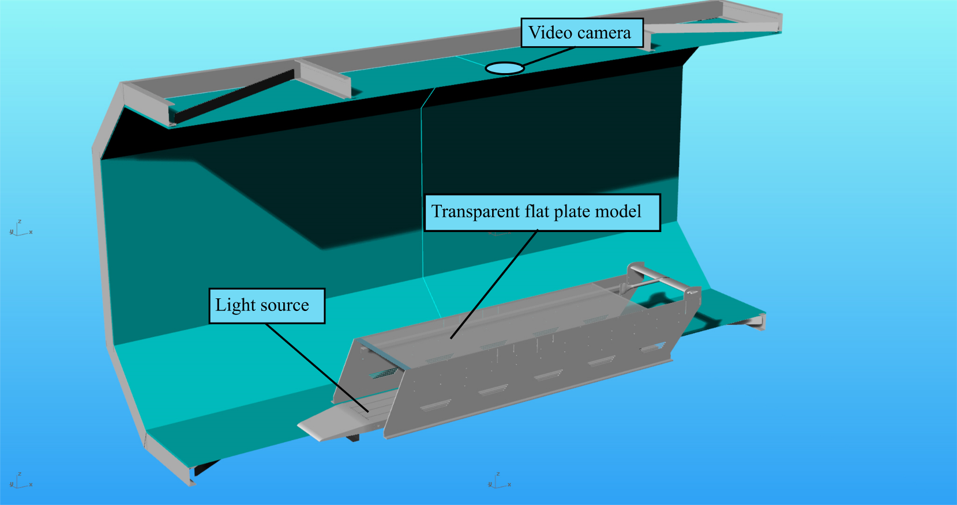
Flat Plate W/T Tests to Evaluate CFD Calculations

Slide 6
Flat Plate Wind Tunnel Model
Pitot – Static Rake
Transparent flat plate - PMMA (acrylic)
Distributed LED-light sources

Slide 7
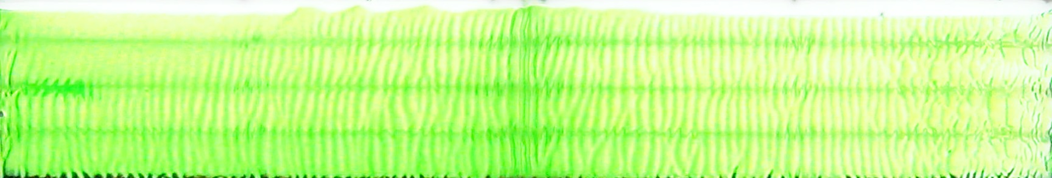
Wave phenomena – Type I
Flow Direction
W/T Speed:
12.2 m/s
15.6 m/s.
Periodic slow waves (K-H or T-S instability) Mass transfer near zero
Transient phase from periodic to solitary waves
Solitary fast waves. Mass transfer proportional to W/T speed

Slide 8
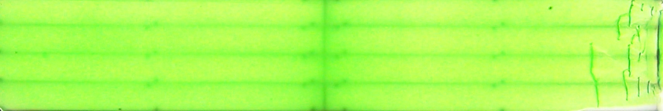
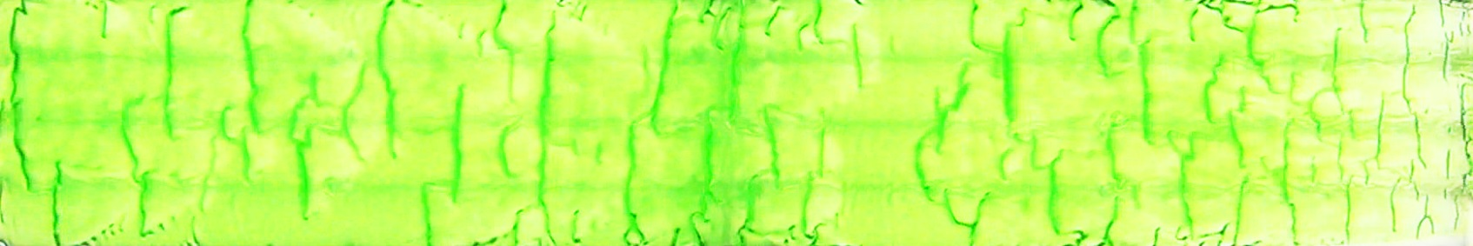
Wave phenomena – Type IV
W/T speed
13.3 m/s
16.8 m/s
No periodic waves – first appearing waves are solitary waves
Mass transfer proportional to W/T speed

Slide 9
CFD with Type I fluids (0.6m and 1.8m models)
Grid sizes: 0.6m model – 160 000 cells, 1.8 m model – 480 000 cells
Calculation times:
Model Simulated time [s] Comp. Time [h] h/s/CPU CPU cores
0.6 m 10.0 669 (28d) 33 2
1.8 m 15.0 4029 (5.6m) 67 4

Slide 10
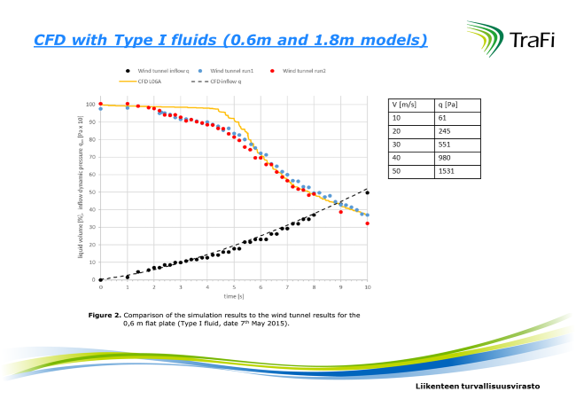
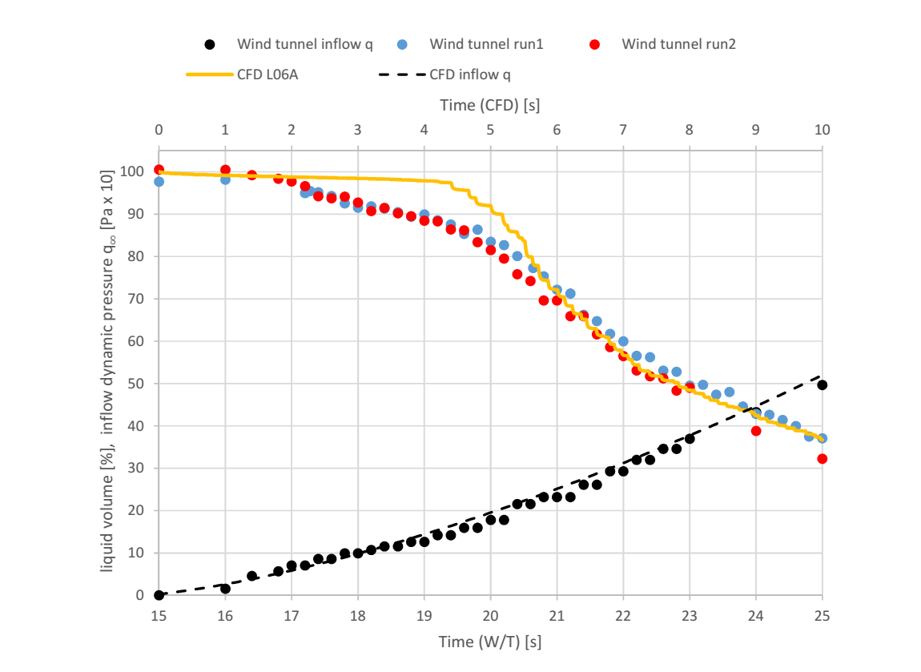
CFD Results Compared to Measurements
0.6 m Flat plate
Total fluid volume
variation and W/T kinetic pressure variation in time

Slide 11
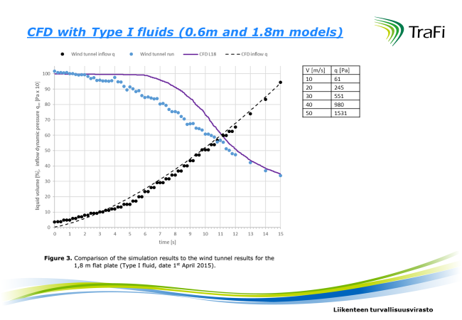

Slide 12
Discrepancies between CFD and measured fluid flow
CFD model does not capture the periodic wave phase
The fluid removal rate in the beginning is slower than measured
Possible reasons:
The initial condition in the simulations is very static, while there are initial disturbances in the wind tunnel due to the idling of the wind tunnel fan.
The resolution of the computational grid is insufficient to capture small waves.
The initial thickness of the fluid was exactly 1 mm in the simulations. The initial thickness of the fluid in the wind tunnel tests is more approximately defined. The initial thickness has an effect on wave height and wave speed and therefore on the removal rate in the beginning
The waves in the simulations are formed at the leading edge of the fluid layer and they must travel the entire plate, while waves are formed all over the flat plate in the wind tunnel test. After the simulations have reached a point where there are waves along the entire length of the flat plate, the removal rate increases.

Slide 13
CFD Studies – T IV Fluids
Preliminary studies for Non-Newtonian fluids (TIV) have appeared challenging – at least for OpenFoam code. Needs more basic research
The problem seems not to be in the power law model but in the too large differences between fluid/air viscosities for the solvers utilized

Slide 14
Appendix

Slide 15
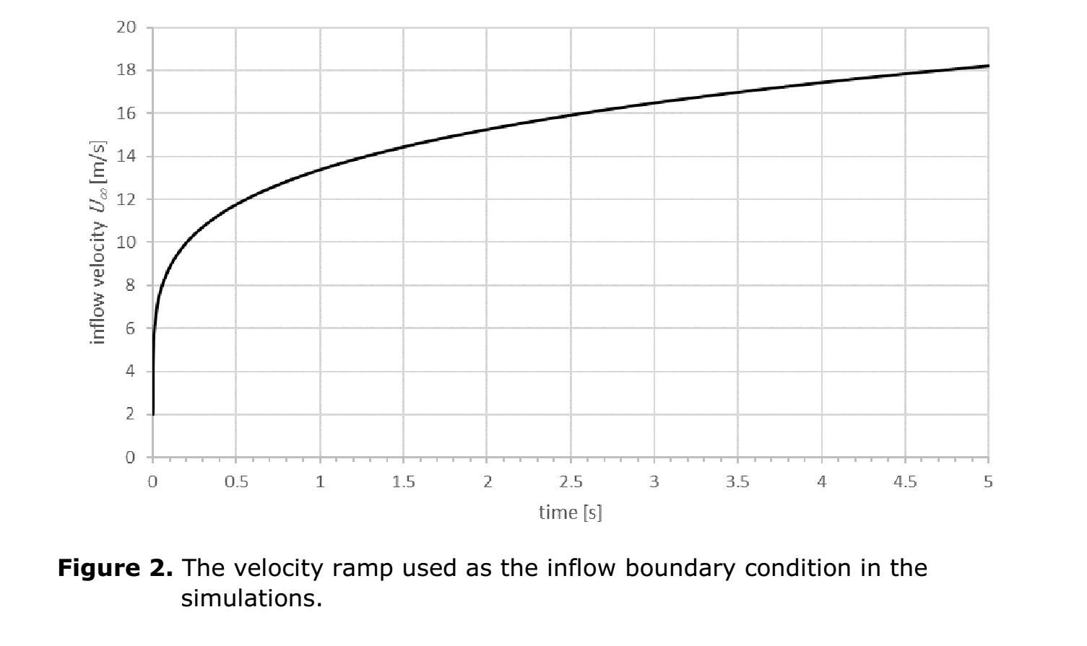

Slide 16
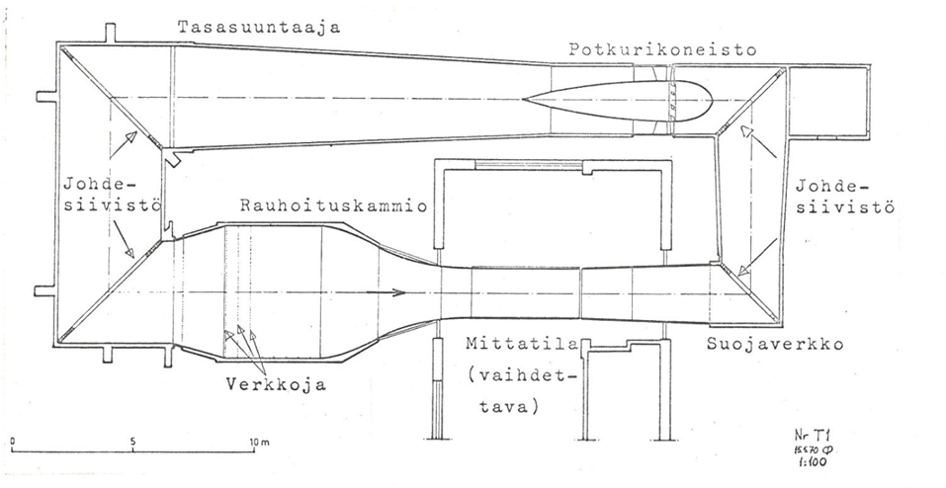
Aalto University Wind Tunnel
Test section:
2m x 2 m
Nominal max speed 70 m/s
Practical maximum 65 m/s
Contraction Ratio = 7.4 (settling chamber is large)
This quarantees the quality of test section air flow

